Slide 1
Innovative Approach to Machine Learning based Network Intrusion Detection System
Course: BACSE203 Computer Network
Submitted by:
Member 1: Abburu Gayatri Sree (25BDE0045)
Member 2: Shashwat Jaiswal (25BDE0060)
Member 3: Swathya Mohit Tulsian (25BYB0104)
Member 4: KH Manishkanda (25BDE0063)
Under the Guidance of: Dr. Priya M, Associate Professor
Date of Submission: 06/10/2026

Slide 2
Table of contents
01
02
03
Abstract
Problem Statement
Proposed Solution
04
05
06
Methodology
Current Progress
Next Phase

Slide 3
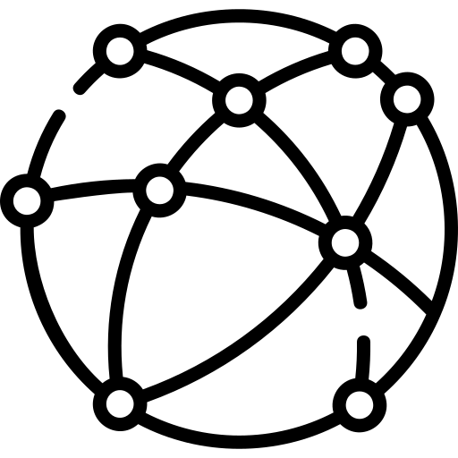
Abstract
This project develops an anomaly-based Network Intrusion Detection System (NIDS) utilizing machine learning to identify complex and zero-day cyber threats.
It bridges high-accuracy threat detection with Explainable AI (XAI) to provide transparent and feature-level root-cause analysis for network administrators.

Slide 4
Problem Statement
Traditional signature-based security systems (e.g. Snort) are highly vulnerable to unknown and/or rapidly evolving cyber threats and payload mutations.
While standard machine learning classifiers improve detection rates, they operate as "black boxes" leaving administrators without proper insight into exactly why a specific network flow was classified as malicious.

Slide 5
Proposed Solution
Model Benchmarking: Compare a hardware-accelerated XGBoost classifier against a stable Random Forest baseline to optimize the trade-off between speed and accuracy.
Explainable AI: Integrate SHAP (SHapley Additive exPlanations) to trace intrusion alerts directly back to their triggering packet attributes.
Interactive Inspection: Build a lightweight Streamlit web dashboard capable of ingesting and analyzing offline network packet captures (.pcap) in real-time.

Slide 6
Methodology
Data Preprocessing: Clean the NSL-KDD benchmark dataset, applying categorical one-hot encoding and standard normalization with zero data leakage.
Model Training: Train both classifiers on the preprocessed matrices, utilizing GPU acceleration (tree_method='hist') for the XGBoost architecture.
Packet Ingestion: Utilize a Scapy-based Python script to extract statistical network features (e.g., flow duration, service flags) directly from Wireshark .pcap files.
UI Integration: Feed the extracted .pcap features through the trained model and SHAP explainer within the Streamlit interface.

Slide 7
Current Progress
Dataset Preprocessing: Successfully engineered a robust data pipeline using the NSL-KDD dataset. Categorical features (protocol, service, flag) were one-hot encoded and continuous features were scaled.
Baseline Model: A Random Forest classifier was trained on the preprocessed training matrices, establishing the system's baseline performance metrics.
Advanced Model: A high-performance XGBoost classifier was trained utilizing optimal hyperparameters to maximize detection capabilities.
Tools & Environment Used: Python, Scikit-learn, XGBoost, Pandas, and NumPy.

Slide 8
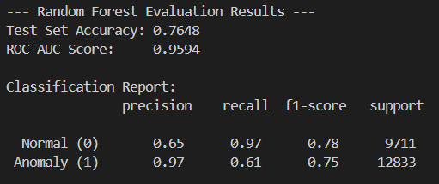
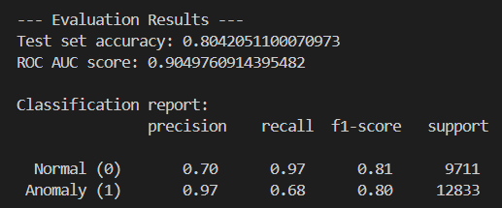
Performance Analysis
Accuracy Benchmark: The XGBoost model successfully outperformed the baseline, achieving an overall accuracy of 80.42% compared to the Random Forest's 76.48%.
Precision (False Positives): Both models achieved an exceptional precision rate of 97% for the anomaly class. Random Forest produced only 266 false positives, while XGBoost produced 307, indicating the system will successfully prevent alert fatigue for administrators.
Recall (Zero-Day Detection): XGBoost identified 8,726 anomalous connections (68% recall), improving upon the baseline's 7,796 detections (61% recall). The models successfully illustrate the inherent difficulty of detecting entirely unseen novel attacks present in the evaluation dataset.

Slide 9
Upcoming Phases
Phase 2 (Explainability): Integrate the SHAP script to extract global feature importance rankings and generate local force plots for individual intrusion alerts.
Phase 3 (Network Integration): Finalize the Scapy .pcap parser to bridge the gap between tabular dataset training and real-world network traffic.
Phase 4 (Dashboarding): Assemble the interactive Streamlit dashboard for live classification and risk visualization.

Slide 10
Thank You

